Slide 1

Program Analysis for Robust Software (CS 4501)
Baishakhi Ray
University of Virginia
http://rayb.info
rayb@virginia.edu
Acknowledgement: tompeha @usersnap, Suman Jana@Columbia, Greg Hoglund@Cenzic, Inc, Omar Chowdhury@Purdue

Slide 2
What is Software Robustness?
A program that performs well under
ordinary conditions
unusual conditions that stress its designers' assumptions
But !!
Software is typically buggy (i.e., contains errors) and fragile, and thus not robust

Slide 3
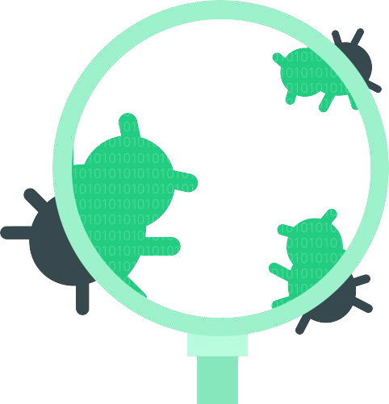
What is a bug?
“A software bug is an error, flaw, failure, or fault in a computer program or system that causes it to produce an incorrect or unexpected result or to behave in unintended ways.”

Slide 4
What is a bug?
incorrect error handling
specification errors
typo errors
copy-paste error
faulty initialization
Incorrect API usage
80%

Slide 5
Why do we care about bugs?

Slide 6
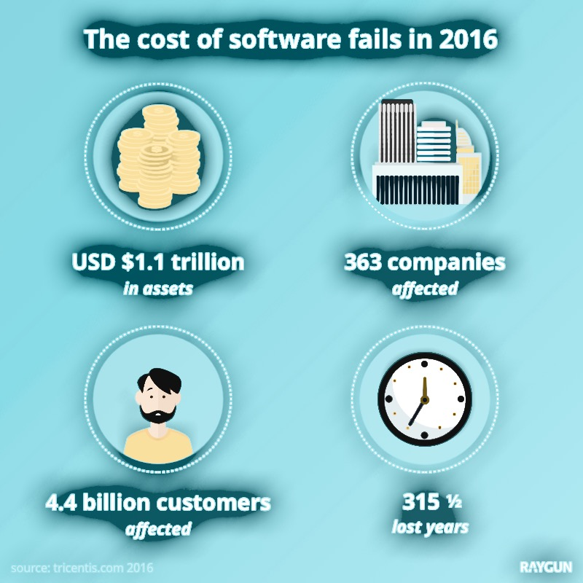
Why do we care about bugs?
Bugs are expensive!!

Slide 7
The Most Expensive Hyphen in History!
On July 22, 1962, Mariner I was launched to conduct a flyby survey of Venus. Within 5 minutes, the mission was “forcefully aborted”. $80 million went to waste (approx. $630 million in today’s currency).
The same week, Richard B.
Morrison, a NASA official,
presented a case for the
rocket’s destruction before
Congress and stressed the
significance of the tiny omission.
Notes:
“The booster had performed satisfactorily until an unscheduled yaw-lift maneuver was detected by the range safety officer. Faulty application of the guidance commands made steering impossible and were directing the spacecraft towards a crash, possibly in the North Atlantic shipping lanes or in an inhabited area. [A range safety officer subsequently ordered its destructive abort.]”

Slide 8
The Most Expensive Hyphen in History!
“[The hyphen] gives a cue for the spacecraft to ignore the data the computer feeds it until radar contact is once again restored. When that hyphen is left out, false information is fed into the spacecraft control systems. In this case, the computer fed the rocket in hard left, nose down and the vehicle obeyed and crashed.”
“For Want of Hyphen, Venus Rocket is Lost”
Notes:
“The booster had performed satisfactorily until an unscheduled yaw-lift maneuver was detected by the range safety officer. Faulty application of the guidance commands made steering impossible and were directing the spacecraft towards a crash, possibly in the North Atlantic shipping lanes or in an inhabited area. [A range safety officer subsequently ordered its destructive abort.]”

Slide 9


Do these look alike?

Slide 10
Navy shoots down Civilian Airliner
IN 1988, the US Vicennes shoots down Airbus 320
290 human lives lost
“cryptic and misleading output displayed by the tracking software “

Slide 11
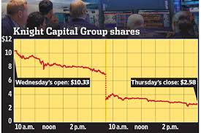
$10M a minute!!
Tremendous financial stress
American financial group Knight Capital lost $440M in a day,
due to a software update error
(https://dougseven.com/2014/04/17/knightmare-a-devops-cautionary-tale/)
American financial group Knight Capital lost $440M in a day,
due to a software update error
Notes:
In today’s world, where our daily lives largely depend on software, really bad things can happen when software goes bad and starts producing errors.
It can cause tremendous financial stress.
For example, in 2012, American financial group Knight Capital's share drops 75% within a day and they lost $440M, due to a software glitch.

Slide 12
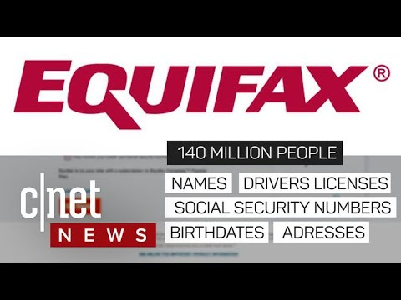
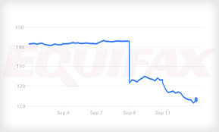
Equifax Data Breach (2017):
Identity theft, Financial loss
Exception handling code outputs message without validation.
The output was constructed to execute OS commands on remote shell.
Notes:
In today’s world, where our daily lives largely depend on software, really bad things can happen when software goes bad and starts producing errors.
It can cause tremendous financial stress.
For example, in 2012, American financial group Knight Capital's share drops 75% within a day and they lost $440M, due to a software glitch.

Slide 13
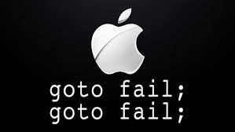
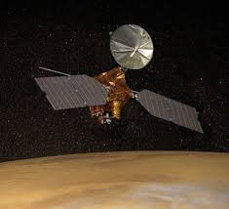
Simple errors, Big headaches
Attacker can capture and modify data in secure network sessions, protected by SSL/TLS (2014).
NASA lost $125M
Measurement type mismatch
Significant loss from trivial programming errors
Notes:
Even simple errors can create big problems.
For example, last year a double use of goto in Apple’s security sensitive code was bypassing a critical check, and this causes significant security risk.
Disaster from such simple coding error is not new.
In 1999, NASA lost $125M as its Mars Climate Orbiter lost its target and burned up in the atmosphere.
The reason: One engineering team was using metric measurements while another team used Imperial units.
So the bottom line is significant loss can happen from trivial programming errors.

Slide 14
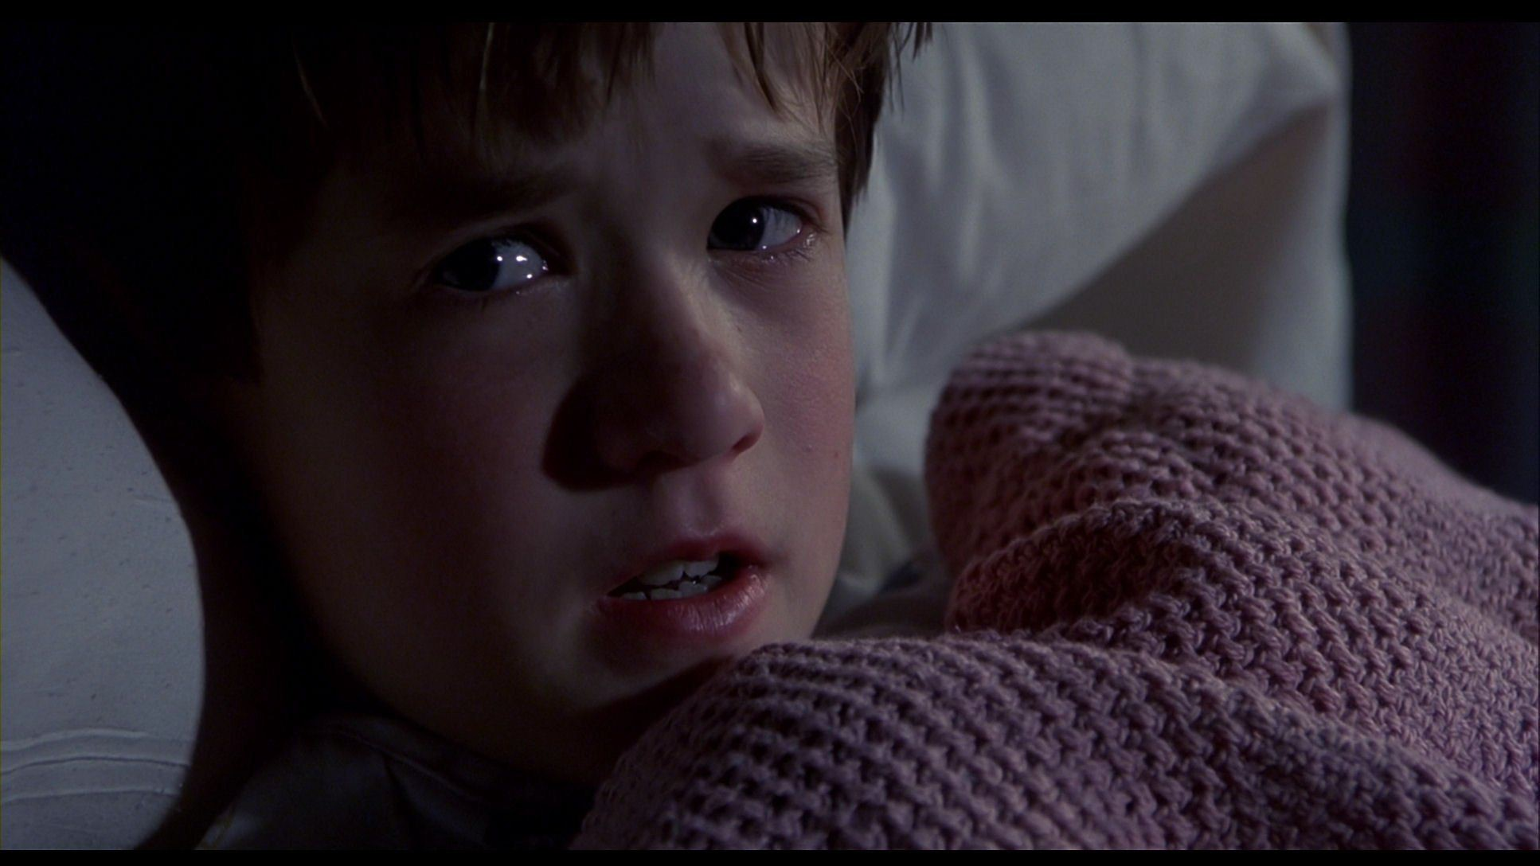
EVERYWHERE
I SEE BUGS
So, how do we solve that problem of bugs?

Slide 15
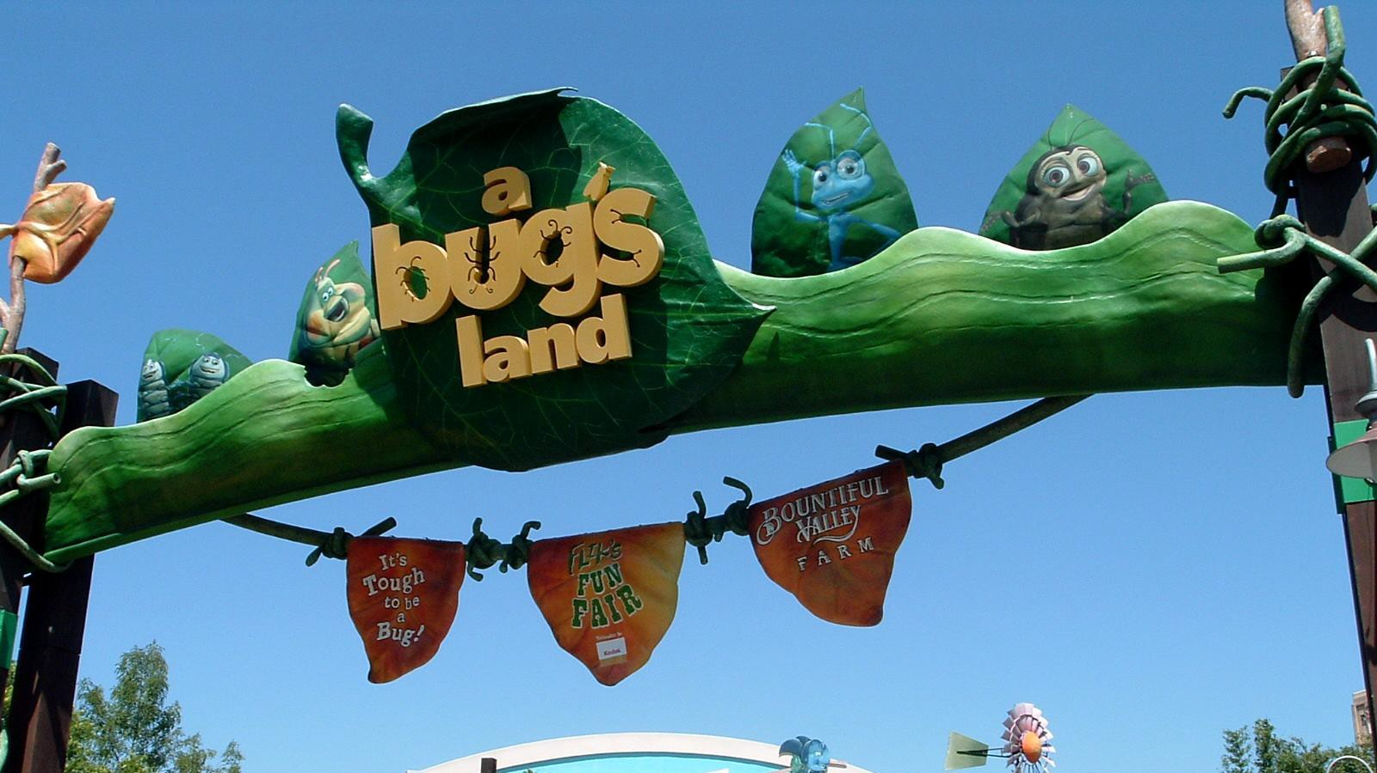
Try to reduce bugs ASAP!!...because

Slide 17
Yeah, but there will always be some bugs.
Try to reduce bugs ASAP!!

Slide 18
Why we have Bugs?
Software is not designed to withstand a hostile environment
Development tools do not prevent simple bugs (even the known one)
QA Testing methods do not address security
Vendors are always in hurry to release a software, even if it is buggy
Customers are willing to pay for bad software
Windows 2000 shipped with 63,000 bugs
Notes:
First real programs were made only 50 years ago

Slide 19
Getting Worse
More connections, devices, and code
In order to compete, new services must be delivered
New types of bugs are emerging
New technology is not being properly tested for failures

Slide 20
How do we deal with bugs?
Automatically find and fix bugs as early as possible.
Monitor a system at runtime to detect and prevent exploits of bugs
Accept that programs will have bugs and design the system to minimize damages
Example: Sandboxes, privilege separation
Focus of this class
Notes:
1/18/18
20
20

Slide 21
Automatically Finding Bugs
Notes:
1/18/18
21
21

Slide 22
Automated bug detection: main challenges
int main (int x, int y)
{
if (2*y!=x)
return -1;
if (x>y+10)
Return -1;
….
… /* buggy code*/
}
What values of x and y will cause
the program to reach here
1. Too many paths (may be infinite)
2. How will program analyzer find inputs that will reach
different parts of code to be tested?
Notes:
1/18/18
22
22

Slide 23
Automated bug detection
Program
Analysis
Static Analysis
- Inspect code or run automated method to find errors or gain confidence about their absence
- Try to aggregate the program behavior over a large number of paths without enumerating them explicitly
Dynamic Analysis
- Run code, possibly under instrumented conditions, to see if there are likely problems
- Enumerate paths but avoid redundant ones

Slide 24
Automated bug detection
Program
Analysis
Static Analysis
- Can consider all possible inputs
- Find bugs and vulnerabilities
- Can prove absence of bugs, in some cases
Dynamic Analysis
- Need to choose sample test input
- Can find bugs and vulnerabilities
- Cannot prove their absence

Slide 25
Automated bug detection
Static Analysis
Verification
Concolic
& White-box
Fuzzing (dynamic)
Extended Static Analysis
Confidence
Symbolic Execution
Ad-hoc testing (dynamic)
Cost (programmer effort, time, expertise)

Slide 26
Grading Policy
Programming Assignments – 50% (5 assignments)
Midterm - 20%
Final - 20%
Class Participation – 10%

